Slide 1
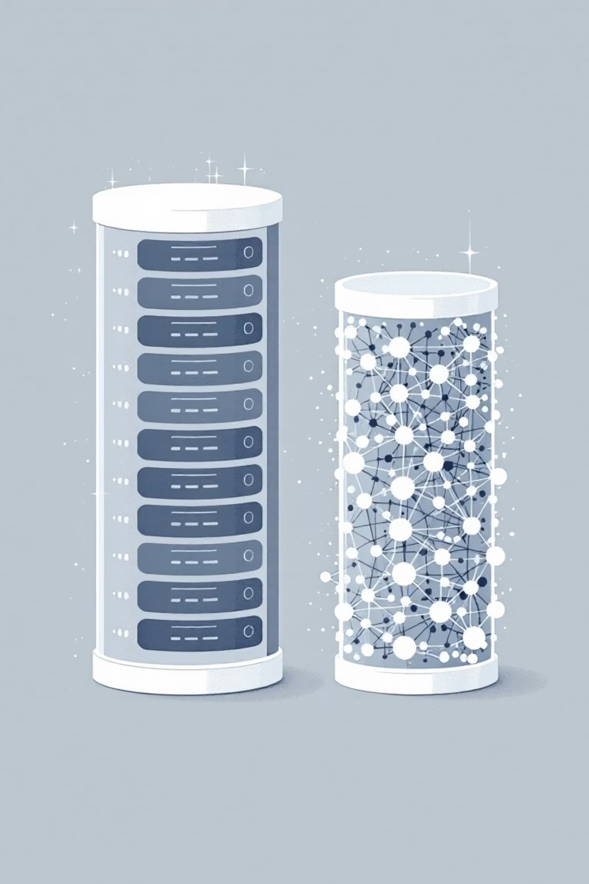
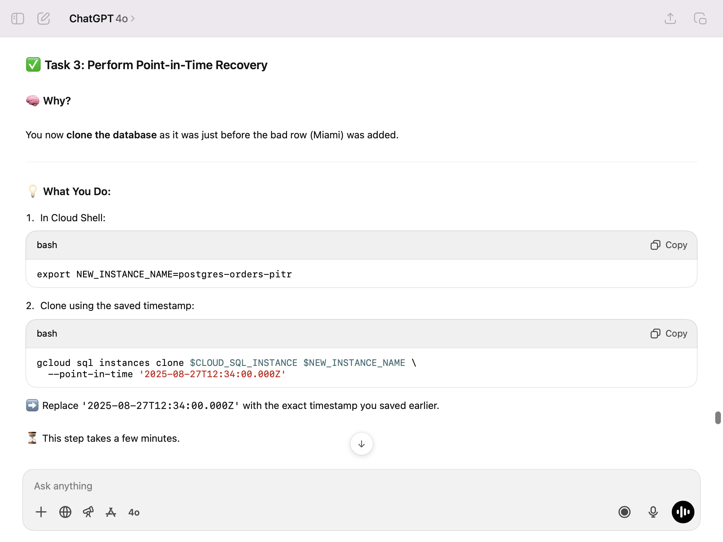
The Shift from Traditional to Gen AI Databases
Generative AI applications require a fundamentally different approach to storing and retrieving data compared to traditional applications. This presentation explores why vector embeddings are crucial and what factors to consider when choosing a Gen AI database.
By Koenig Solution
Notes:
**(Slide Title: The Shift to Gen AI Databases)**
Good morning/afternoon, everyone. Traditional databases aren't cut out for the demands of Generative AI. This presentation will show why vector embeddings are key to handling Gen AI's unique data requirements, and guide you through the crucial considerations when selecting the right Gen AI database for your needs. Let's explore the difference.

Slide 2

Traditional vs. Gen AI Databases
Traditional Databases
Gen AI Databases
Store structured data in rows and columns
Handle unstructured data (text, images, audio)
Find data by matching exact values
Understand meaning and context
SQL queries for precise matches (e.g., "find all carnivores")
Find semantically similar items
Rely on vector embeddings
By Koenig Solution
Notes:
Slide Title: Traditional vs. Generative AI Databases
**(Speaker Notes):** This slide contrasts traditional and Gen AI databases. Traditional databases excel at structured data, using SQL for precise queries. Think "find all carnivores." In contrast, Gen AI databases handle unstructured data like text and images, understanding meaning and context to find semantically similar items using vector embeddings. This is a key differentiator, showcasing the power of Gen AI in data management. (Mention Koenig Solution's role briefly if appropriate, e.g., "Koenig Solution provides solutions bridging this gap.")

Slide 3



What Are Vector Embeddings?
A vector embedding converts unstructured data—like words, sentences, or images—into a list of numbers (a vector) representing its position in a high-dimensional space.
Unstructured Data
Embedding Process
Vector Database
Text, images, audio files
Convert to numerical vectors
Store in high-dimensional space
The key feature: semantically similar items are placed closer together in this space. For example, "lion" and "tiger" vectors would be close, while "car" would be far away.
By Koenig Solution
Notes:
Slide Title: What Are Vector Embeddings?
**(Speaker Notes):** We're looking at vector embeddings – a powerful technique to represent unstructured data like text, images, and audio as numerical vectors. This process converts the data into a list of numbers, positioning it within a high-dimensional space. Critically, semantically similar items are clustered together. Think "lion" and "tiger" being close, while "car" is distant. Koenig's solution leverages this by storing these vectors in a specialized vector database, enabling efficient similarity searches.

Slide 4

Semantic Search with Vector Embeddings
Traditional Search
Semantic Search
"Find the animal named 'lion'"
"Find animals similar to a 'lion'"
Exact match required
Returns tigers, leopards, cheetahs
Misses related concepts
Understands relationships
Limited to structured data
Works with unstructured data
By Koenig Solution
Notes:
Slide Title: Semantic Search vs. Traditional Search
**(Speaker Notes):** This slide contrasts traditional keyword-based search with our semantic search solution using vector embeddings. Traditional search relies on exact matches, missing related concepts (as shown with "lion"). It's also limited to structured data. Our semantic search, however, understands relationships and returns conceptually similar results, even with unstructured data. See how a query for animals "similar to a lion" yields tigers, leopards, and cheetahs – demonstrating the power of the Koenig Solution.

Slide 5
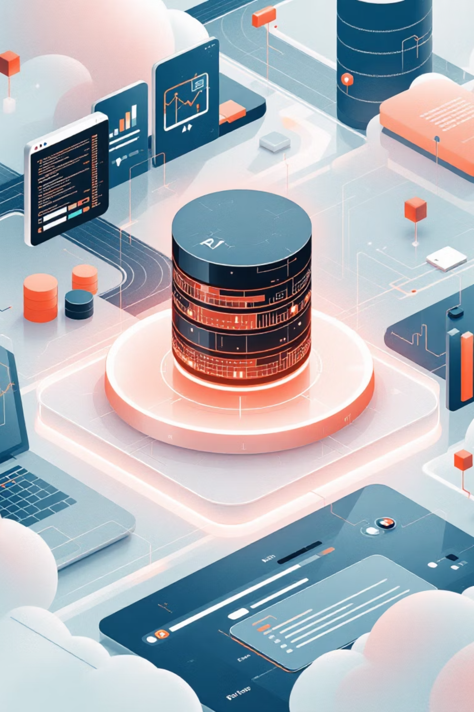
Key Factors for Choosing a Gen AI Database
Support for Vector Search
Database must efficiently store vectors and perform fast similarity searches
Examples: AlloyDB, Spanner, and Cloud SQL for PostgreSQL
Integration with AI/ML Platforms
Should connect easily with AI platforms like Google's Vertex AI to simplify creating embeddings and using foundation models
By Koenig Solution
Notes:
**(Slide Title: Choosing the Right Gen AI Database)**
Good morning/afternoon, everyone. This slide highlights key factors when selecting a database for your generative AI applications. Crucially, it needs robust **vector search** capabilities for efficient similarity searches on embeddings. Examples include AlloyDB, Spanner, and Cloud SQL for PostgreSQL. Furthermore, seamless **integration with AI/ML platforms** like Google's Vertex AI is essential for streamlined workflow and leveraging foundation models. Thank you.

Slide 6



Scale and Performance
Gen AI deals with enormous datasets and requires rapid responses.
AlloyDB
Spanner
Memorystore
Extremely fast queries (transactional, vector, and analytical)
Scales almost infinitely to handle global traffic and massive datasets, ideal for large language models
In-memory storage for caching, offering fastest possible data access for frequently used information
By Koenig Solution
Notes:
Slide Title: Scaling Gen AI with Google Cloud
**(Speaker Notes):** This slide highlights the critical need for scalable and performant infrastructure to support Generative AI's massive data requirements and rapid response times. We leverage Google Cloud's powerful solutions: AlloyDB for blazing-fast transactional, vector, and analytical queries; Spanner for virtually limitless scalability to handle global traffic and immense datasets ideal for LLMs; and Memorystore for in-memory caching, ensuring the fastest data access for frequently used information. This robust architecture, powered by Koenig Solution, guarantees optimal Gen AI performance.

Slide 7
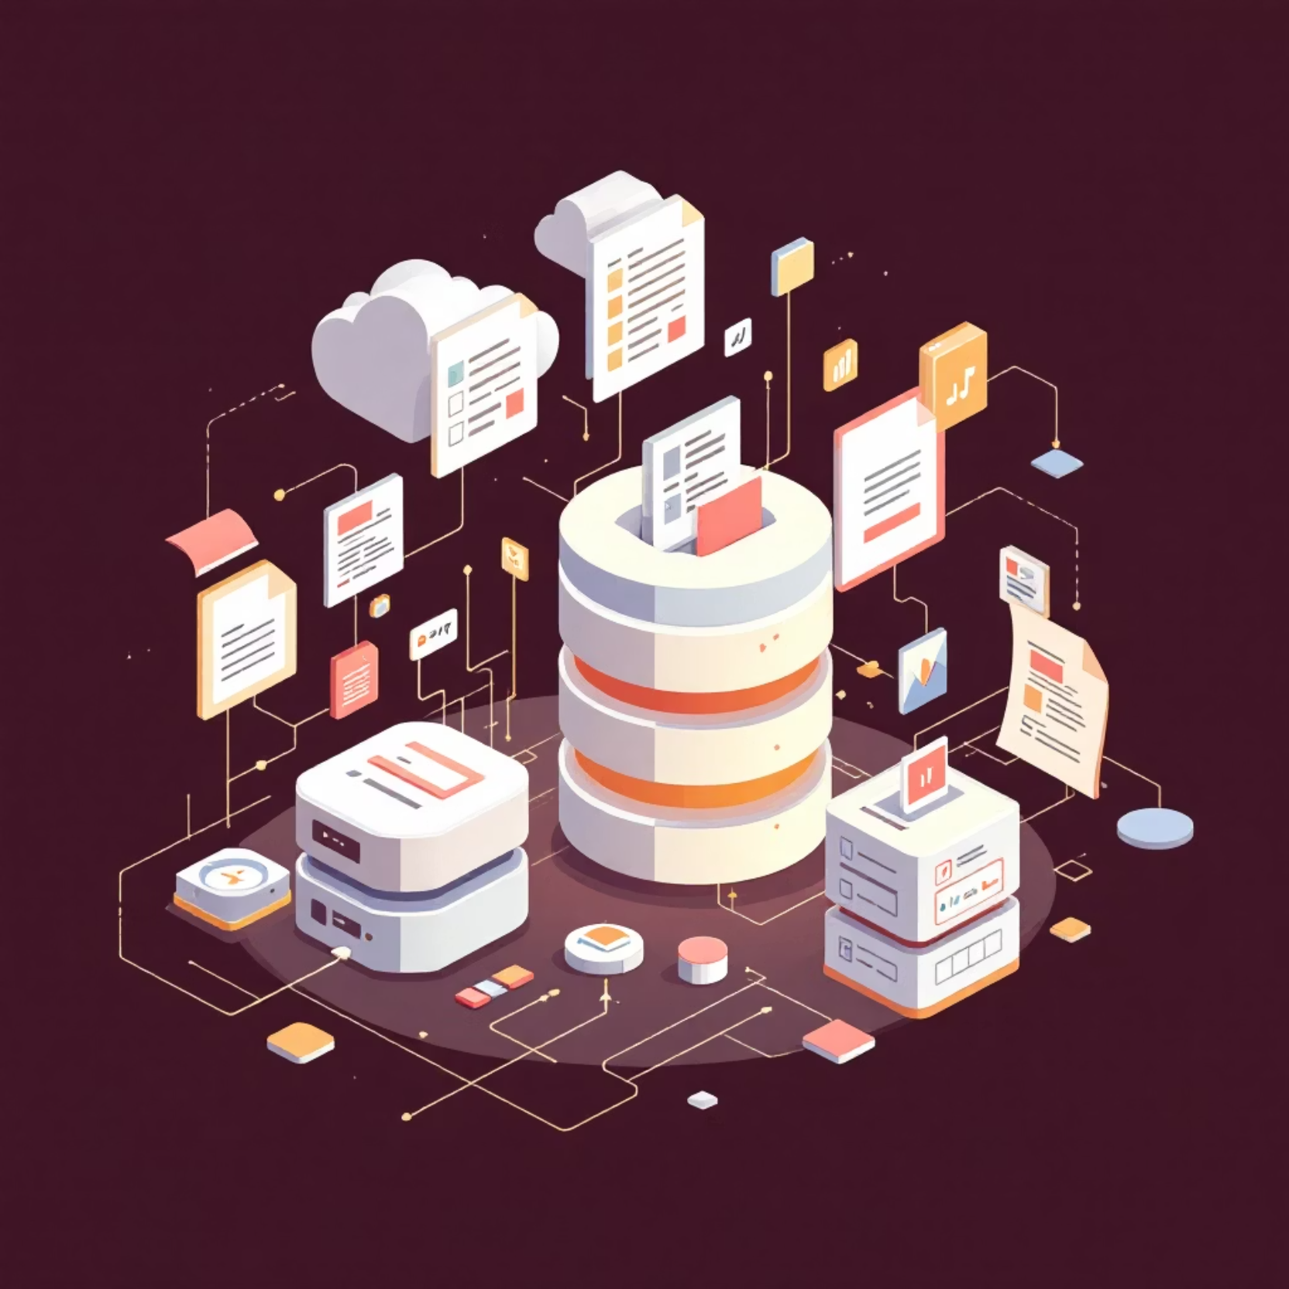
Data Flexibility
Gen AI applications often use diverse data types:
BigQuery
Best for analyzing petabyte-scale structured and semi-structured datasets
Firestore
Great for flexible, document-style data (unstructured or semi-structured) requiring real-time updates
By Koenig Solution
Notes:
Slide: Data Flexibility
(Speaker Notes) Good morning/afternoon, everyone. This slide highlights the diverse data handling capabilities crucial for successful Gen AI applications. We leverage Google Cloud's robust data solutions. BigQuery is ideal for massive, structured datasets – think petabytes of data. Firestore, on the other hand, excels with flexible, document-based data that requires real-time updates. This combination, a Koenig Solution, ensures our AI models are fed the right data, in the right format, at the right time.

Slide 8


Cost and Operational Efficiency
Storing huge amounts of data can be expensive.
Fully-managed databases like AlloyDB and Cloud SQL reduce the need for manual administration, which lowers operational costs.
When choosing a Gen AI database, consider both direct storage costs and the hidden costs of administration and maintenance.
By Koenig Solution
Notes:
Slide: Cost & Operational Efficiency
**(Speaker Notes):** Managing large datasets is costly. Traditional databases require significant manual administration, driving up operational expenses. AlloyDB and Cloud SQL, being fully managed, significantly reduce these hidden costs. When selecting a Gen AI database, remember to factor in both direct storage costs *and* the often-overlooked administrative and maintenance overhead. Koenig Solution helps you optimize for both.

Slide 9

Security and Data Protection
Encryption
Access Control
Advanced Security
Databases like AlloyDB, Cloud SQL, Spanner, and Firestore automatically encrypt data both at rest and in transit
Integration with IAM (Identity and Access Management) lets you control exactly who can see or modify data
AlloyDB provides extra features like model endpoint management to protect your application from malicious attacks
By Koenig Solution
Notes:
(Slide Title: Security & Data Protection)
Good morning/afternoon. This slide highlights our robust security measures. We utilize automated encryption at rest and in transit for databases like AlloyDB, Cloud SQL, Spanner, and Firestore. Granular access control, integrated with IAM, ensures only authorized users can access and modify data. Furthermore, advanced features in AlloyDB, such as model endpoint management, offer an additional layer of protection against malicious attacks. This commitment to security is central to the Koenig Solution.

Slide 10
Key Takeaways
Different Needs, Different Solutions
Choose the Right Database
Vector Embeddings Are Essential
Consider vector search support, AI integration, scale, flexibility, cost, and security
AlloyDB, Spanner, BigQuery, and Firestore each excel in different Gen AI scenarios
They enable semantic search and understanding of unstructured data
The shift to Gen AI databases represents a fundamental change in how we store, retrieve, and understand data.
By Koenig Solution
Notes:
**(Slide Title: Key Takeaways)**
* **Vector embeddings are crucial:** Enable semantic search & understanding of unstructured data (key for Gen AI).
* **Database selection is critical:** Prioritize vector search, AI integration, scalability, flexibility, cost, & security.
* **One size doesn't fit all:** AlloyDB, Spanner, BigQuery, & Firestore offer specialized Gen AI solutions.
* **Fundamental shift:** Gen AI databases redefine data storage, retrieval, and understanding. (Koenig Solution)

